Slide 1
Booker T. Washington
High School
Annual Title I Meeting
2024-2025
Escambia County School District
Notes:
Script:
Welcome: Welcome Families, to our school’s Title I Annual Meeting.
Introductions:
I’m ______________; I’d also like to introduce: ______________
Purpose:
The purpose of the Title I Annual Meeting is to provide information to families of participating children about the Title I program and their right to be involved in their child’s education.

Slide 2
Topics to be Discussed
Overview of Title I
Program and services at our school
Summary of our Parent and Family Engagement Plans
Share our School-Family Compact
Questions & Comments
8/10/23
Notes:
Script:
Agenda: This evening, we will will share with you
What Title I is
The programs implemented at our school related to Title I
A summary of the district & our school’s Parent & Family Engagement Plans
and the School-Family Compact

Slide 3
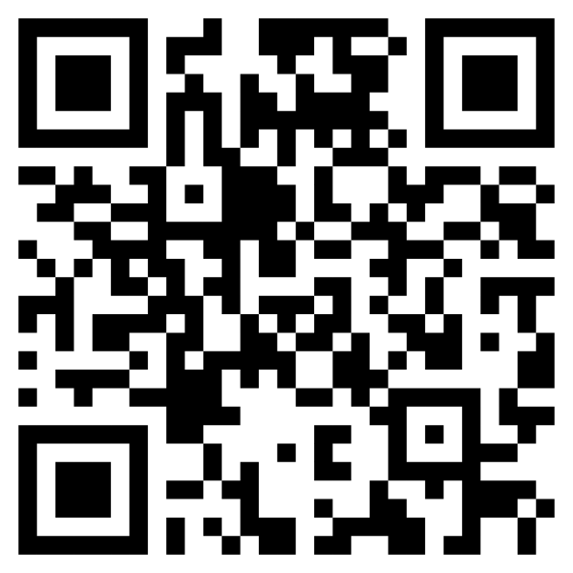
Video is also available in Spanish, Vietnamese, and Chinese through this QR code:
Click here to play the video:
Annual Meeting Supplemental Video 24-25
8/10/23
https://tinyurl.com/285ccbga
Notes:
The next short video answers the question “What is Title I?”
All of the links in the presentation are also available on your agenda.
The information in the video is also available in Spanish, Vietnamese, and Chinese by accessing the QR code on the slide or your agenda.

Slide 4
Academic Achievement
(2023-2024 Results)*
Total Title I
Funds
$231,870.00
Set-aside for Parent & Family Engagement
$7,860
Title I Schoolwide
Program Summary
Washington High School
ELA Achievement
46%
Schoolwide Program Goals
Curriculum Programs
85% of our students will have fewer than five absences during the school year.
We plan to exceed the district and state averages in learning gains and achievement levels in the area of math through continued progress.
Increase enrollment in acceleration in each Black/African American and SWD subgroups by 2%.
iLIT 45
SONDAY system
School-wide Literacy Initiative
Star 360
USA Test Prep
Academies
PBIS Programs
Math Achievement
39%
Science Achievement
72%
Social Studies Achievement
69%
Additional Staff
Supplemental Methods and Materials
Professional Development
Parent and Family Engagement Events
53%
Acceleration
2021-2022
Classroom teacher to alleviate class size
Science lab equipment
ELA resources
Math resources
Social Studies resources
Library resources
Technology supplies
Visible Learning for Teachers - Maximizing Impact on Learning in the Classroom
Senior Family Night
College and Career Readiness
Feeder School Progression Night
Graduation Requirements
Graduation Rate
2021-2022
87%
*Access edudata.fldoe.org for additional data and analysis
Si usted no entiende esta información debido a una barrera idiomática favor de ponerse en contacto con la escuela de su niño(a). Gracias.
Nếu quý vị không hiểu tin tức này bởi vì ngôn ngữ bất đồng, xin vui lòng liên lạc với trủờng học của con quý vị để được bản dịch của tin tức này. Thành thật cám ơn.
Notes:
School grades for this year are not yet available but will be available in November.
Our most recent academic achievements are listed on the left side of the slide. The school grade and proficiency scores are based on last spring’s FAST testing.
Graduation and Acceleration data is based on the 2023-2024 school year. This information was updated this fall.
Our school goals this year include our school improvement goal that 85% of students will have fewer than 5 absences and the overall school will have increased learning gans .
Instruction, programs and practices at our school that support our academic achievement include a PBIS program which stands for Positive Behavior Intervention and Support. We also have the Academies and a variety of computer based academic programs designed to help students.
To help support our goals, our school receives $$231, 870 Total Title I funding; at a minimum, we must spend $7,860.00_________ on parent and family engagement activities.
Our school is using our Title I funds to …
Hire additional classroom teachers to alleviate class size
New supplemental methods and materials for all content areas
Professional Development for staff in the area of Trauma Informed Care
And a few programs for parent and family engagement that includes SENIOR family night, College and Career REadiness, Feeder School Progression Night and meeting with families about Graduation Requirements.

Slide 5
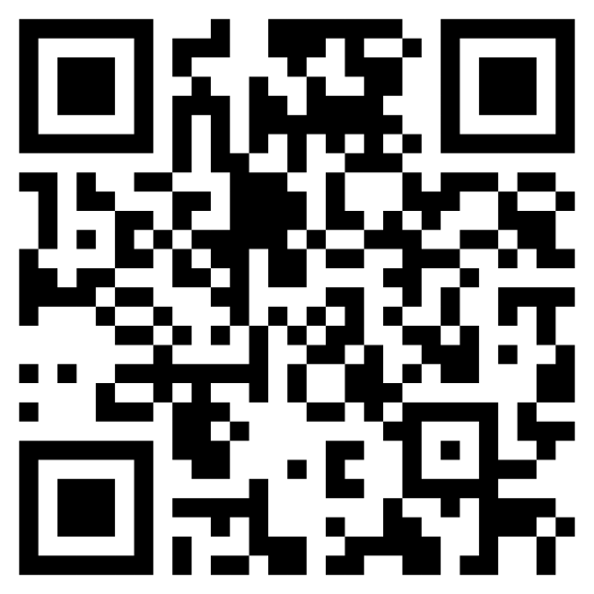
Summary of Our Parent & Family Engagement Plans
Escambia County School District
Parent and Family Engagement Plan
District-level PFEP is a blueprint of how the District and Title I schools work together with families. Some of these ways are:
Conduct an annual evaluation of our plan with family members
Assist schools in planning and implementing effective family activities
Our School
Parent & Family Engagement Plan
School-level PFEP gives specific information on how we will work together with families. Some of these ways are:
Involve families in the decision making process
Build the capacity of families and staff for strong family engagement through best practices
You may find the full Escambia County Title I District and our School’s PFEP
on the Title1.org website
or by contacting your school.
Our school’s Parent and Family Engagement Plan was developed with input from family members, and other stakeholders, through School Advisory Council meeting(s) and from survey results.
8/10/23
Notes:
Script:
The Parent & Family Engagement Plans outline how our district and our school will work together with families to improve the academic achievement of students.
The district plan was developed with the input of families, schools, and community members throughout last year.
Our school’s plan was developed with input from families, staff, & community members through School Advisory Council meetings and online surveys last spring. Watch for these same development opportunities next spring. We want your input.

Slide 6
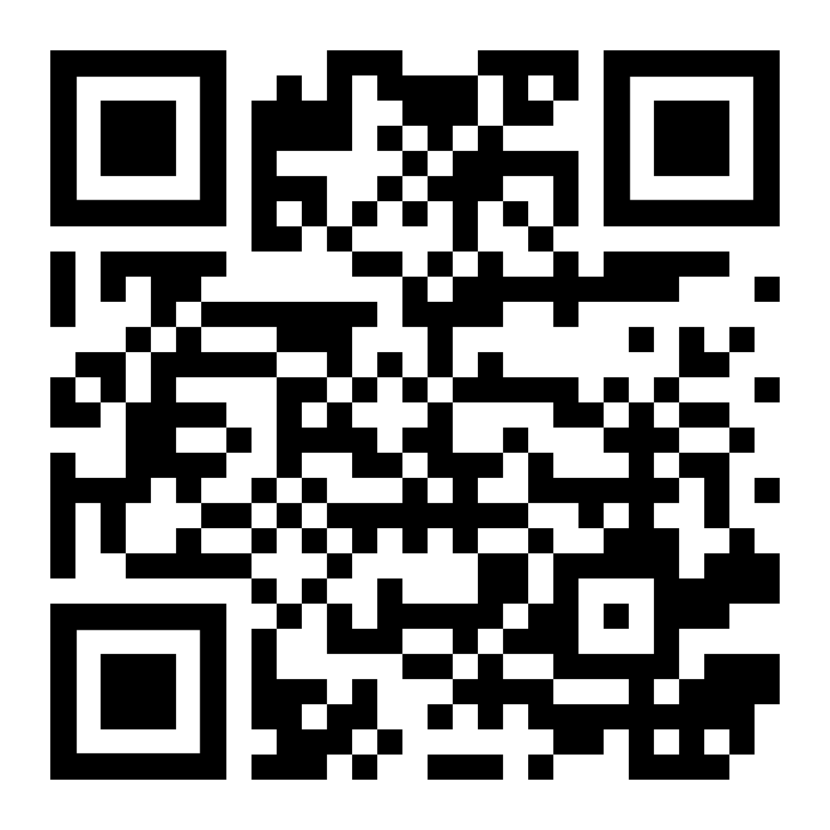
Our School-Family Compact
Partnering to help students improve academic achievement.
For Families: As a parent/guardian I will share the responsibility for my child’s success and progression in their academic achievement. Specifically, I will…
Provide current address and phone numbers to the school
Monitor my child’s grades through the FOCUS parent portal, and communications with their teacher
Read notices and communications sent home with my child and respond as needed
Emphasize the importance of education on a regular basis
Notes:
Script:
Each year, we revisit our school-family compact.
Our school-family compact identifies the activities families, the entire school staff, and the students will undertake to share the responsibility for improved student academic achievement. This compact was written after seeking input from families, students, and staff.

Slide 7
Our School-Family Compact
Partnering to help students improve academic achievement.
For Students: As a student I will share the responsibility to improve my own achievement or exceed state standards.
Specifically, I will…
Show respect for myself, my school, my peers, and my teachers
Commit to graduate on time
Complete my homework and classwork daily, utilize the knowledge of my teachers and family, and use any available resources given me when needed
Follow the student Code of Conduct as outlined in the Student Handbook and dress appropriately in accordance with the ECSD Dress Code Policy
Relay all messages, notices, and handouts to my parent/guardian
Work to the best of my ability, focusing on my subject areas, participating in class discussions, and refusing to act out in class with disruptive behavior
Notes:
Script:
Each year, we revisit our school-family compact.
Our school-family compact identifies the activities families, the entire school staff, and the students will undertake to share the responsibility for improved student academic achievement. This compact was written after seeking input from families, students, and staff.

Slide 8
Our School-Family Compact
Partnering to help students improve academic achievement.
For School Employees: As Principal of Booker T. Washington High School, I will share the responsibility, along with my faculty and staff, for improving student achievement and will nurture a partnership to help students graduate within four years. Specifically, I will…
Provide a safe, orderly, supportive environment in which students have the maximum opportunity for academic success
Make decisions regarding high quality curriculum and instruction based on data and recent research that will enable students to meet state standards, and prepare students for life-long learning and the world of work
Provide an environment that allows for positive communication among the student, teacher, and family
Ensure the communication of each student’s state assessment results, academic achievement and progress towards graduation
Support school-based parent organizations and encourage students to develop school pride, spirit and enthusiasm through sports, activities, school-sponsored events, and club opportunities
Notes:
Script:
Each year, we revisit our school-family compact.
Our school-family compact identifies the activities families, the entire school staff, and the students will undertake to share the responsibility for improved student academic achievement. This compact was written after seeking input from families, students, and staff.

Slide 9
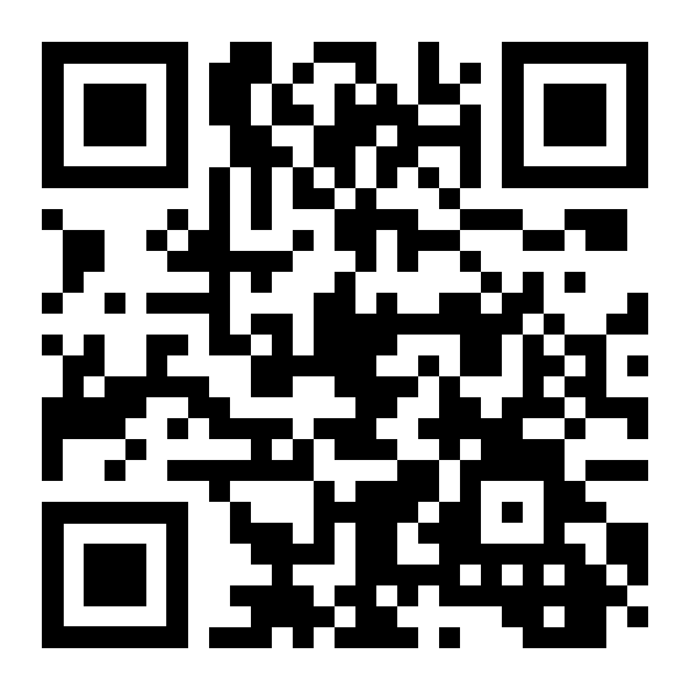
Questions or Comments
or Contact Our School
(850) 475-5257
https://www.escambiaschools.org/whs
Graphic Credits
Icons by Flaticon
Images & infographics by Freepik
Title slide photo created by torwaiphoto - Freepik.com
Requirements slide photo created by user18526052 - Freepik.com
Together photo created by creativeart - Freepik.com
Success photo created by jcomp - Freepik.com
Sign-in icon designed by prosymbols - Freepik.com
Thank You
Notes:
Thank you for your time and if you have any questions, please let us know.

